Slide 1
Genetic Selection as a Tool for Improving Milk Solids
John B. Cole, PhD
NCCIA Conference | October 16, 2025

Slide 2
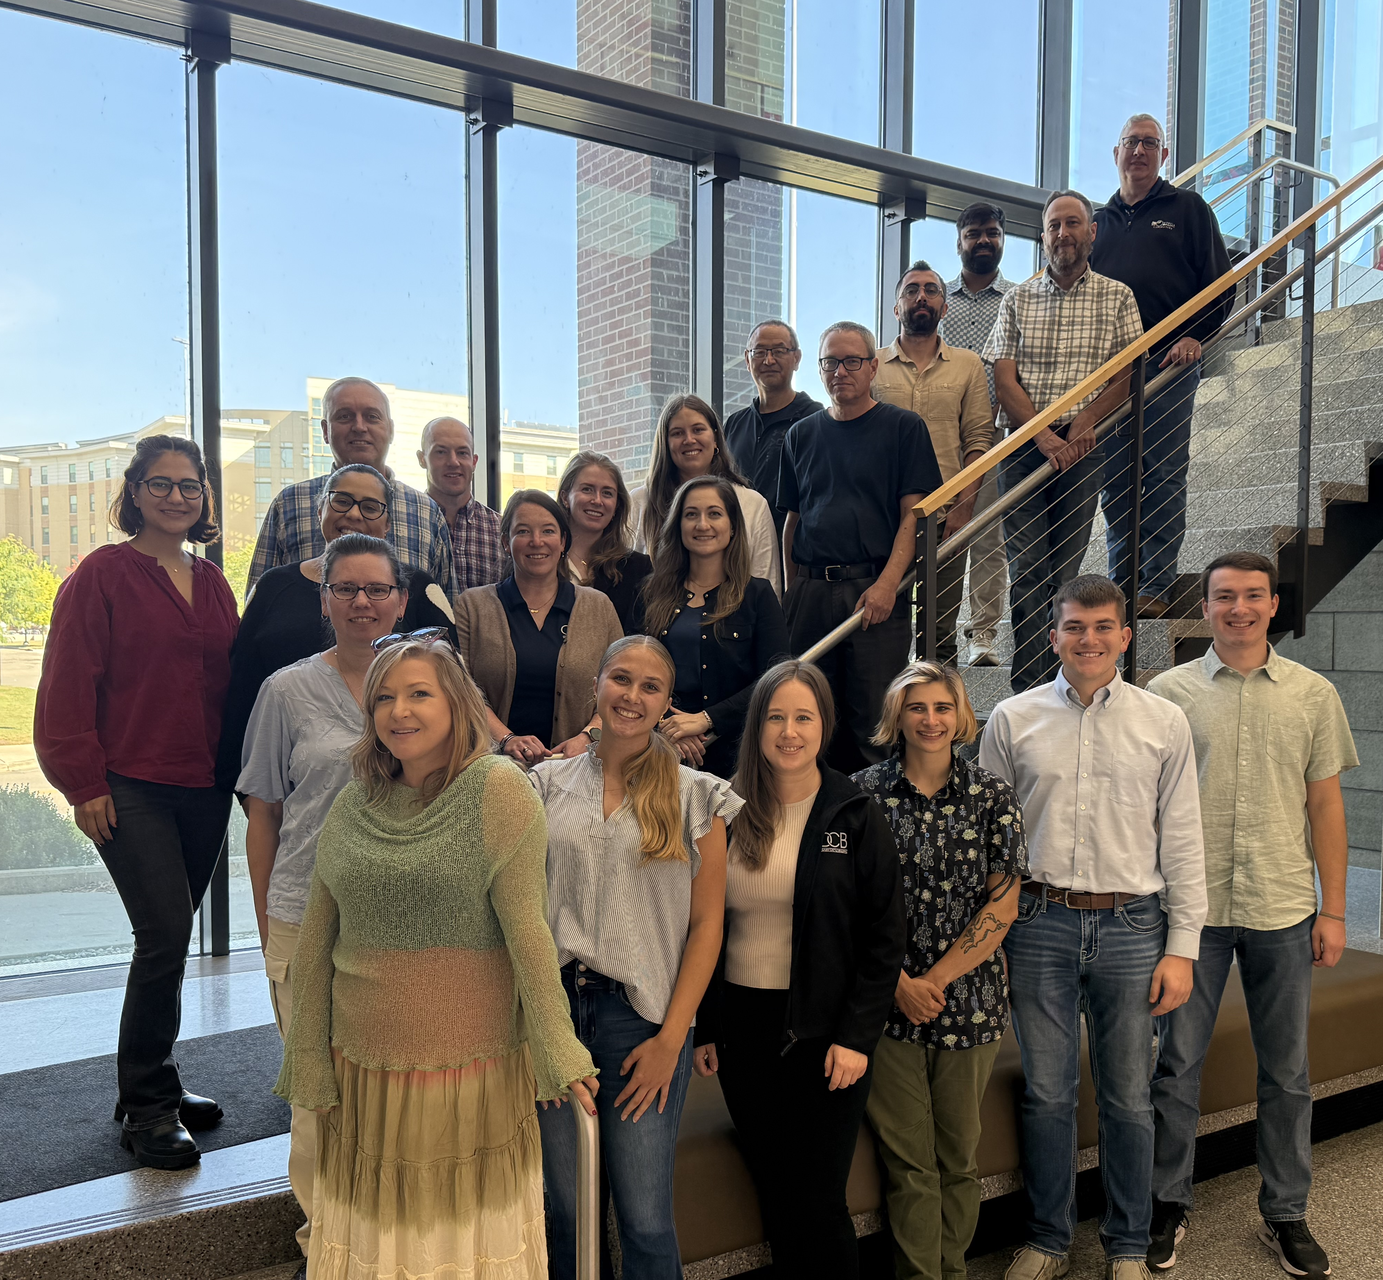
Topics
What is CDCB?
How does genetic improvement work?
What new tools are on the way?
Closing thoughts
CDCB scientists with Land Grant university faculty and students at the October 2025 annual meeting of multistate project S-1096 at University of Wisconsin.

Slide 3
What is CDCB?

Slide 4
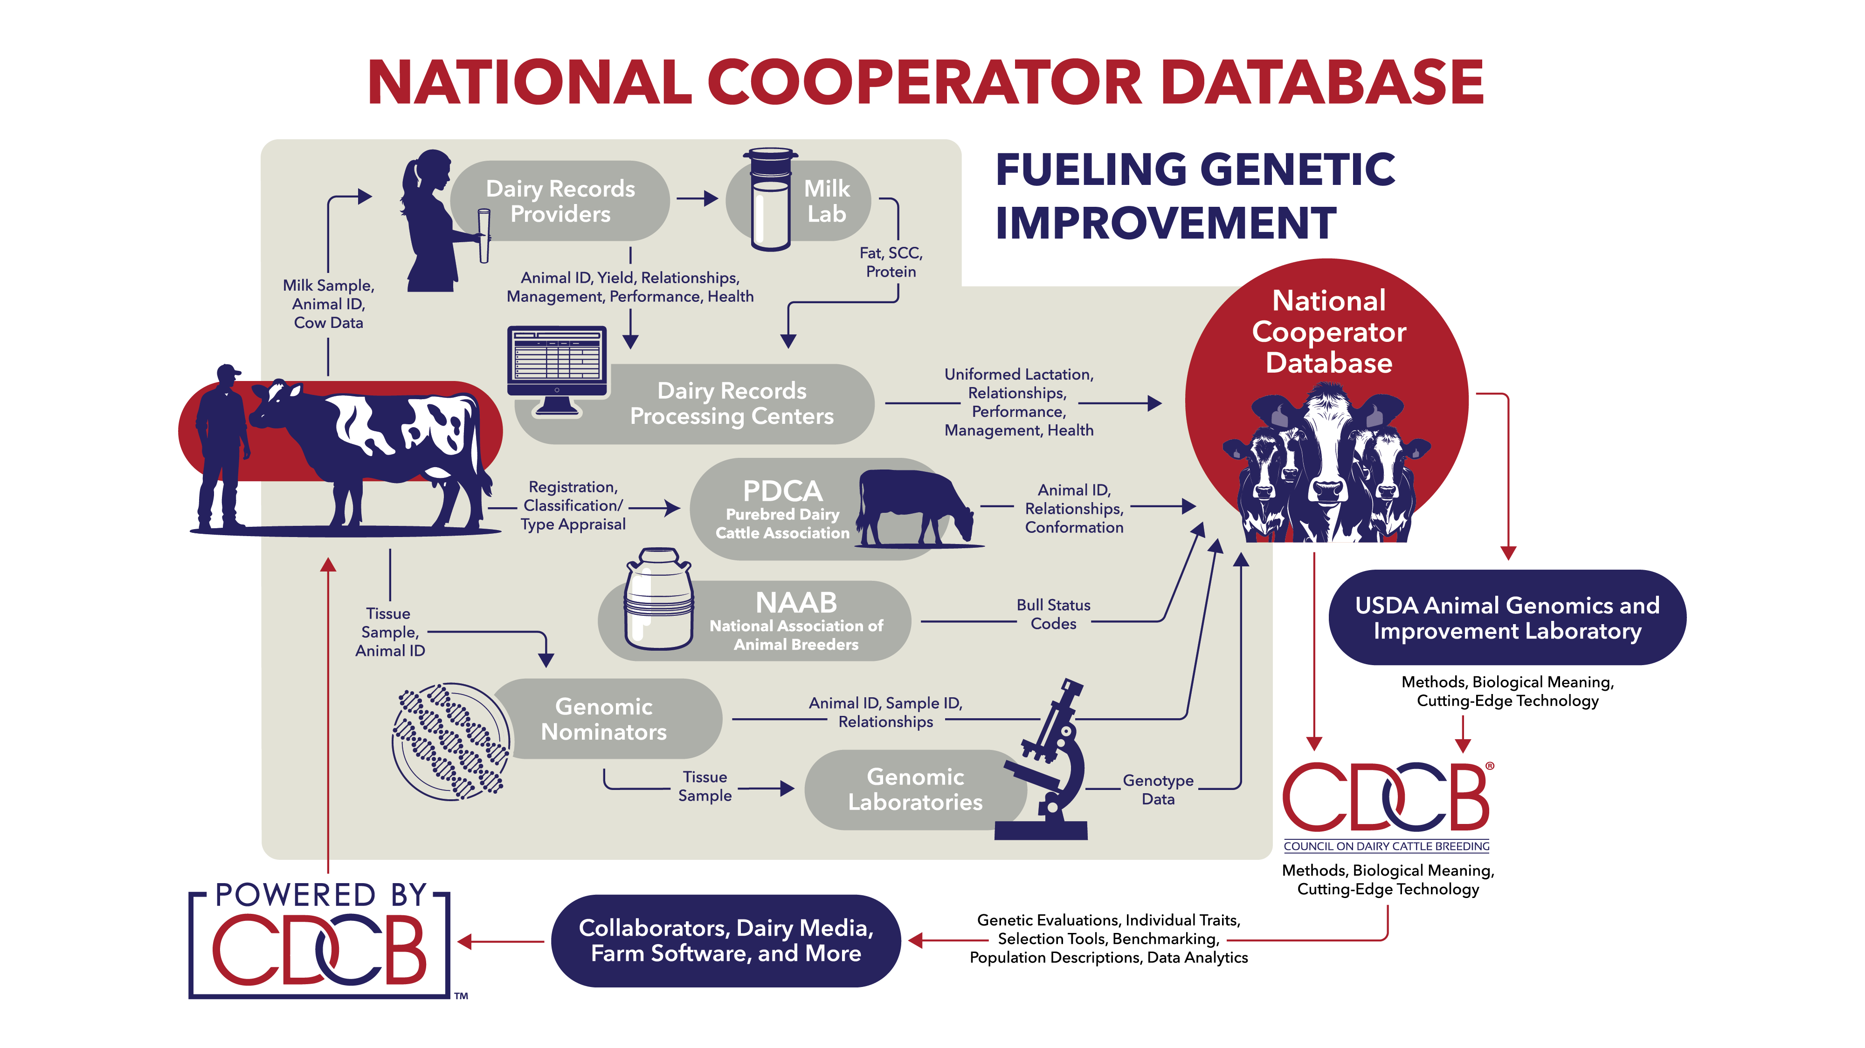

Slide 5
National Cooperator Database
Lactation
108.7 million
SCS
72.2 million
Cow Livability
127.2 million
Fertility
99.8 million
Health Traits
12.5 million
Calving Ease
40 million
Type (non-HO)
3.6 million
Residual Feed Intake
11,095
Counts from December 2024 evaluations

Slide 6

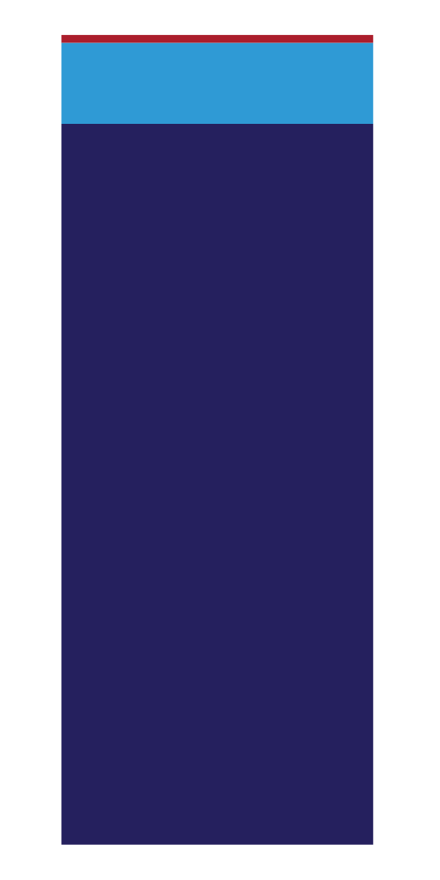
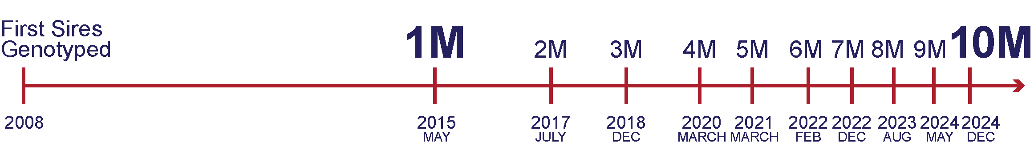
National Cooperator Database
10%
JERSEY
93%
72
89%
HOLSTEIN
FEMALE
COUNTRIES
Counts from December 2024 evaluations

Slide 7
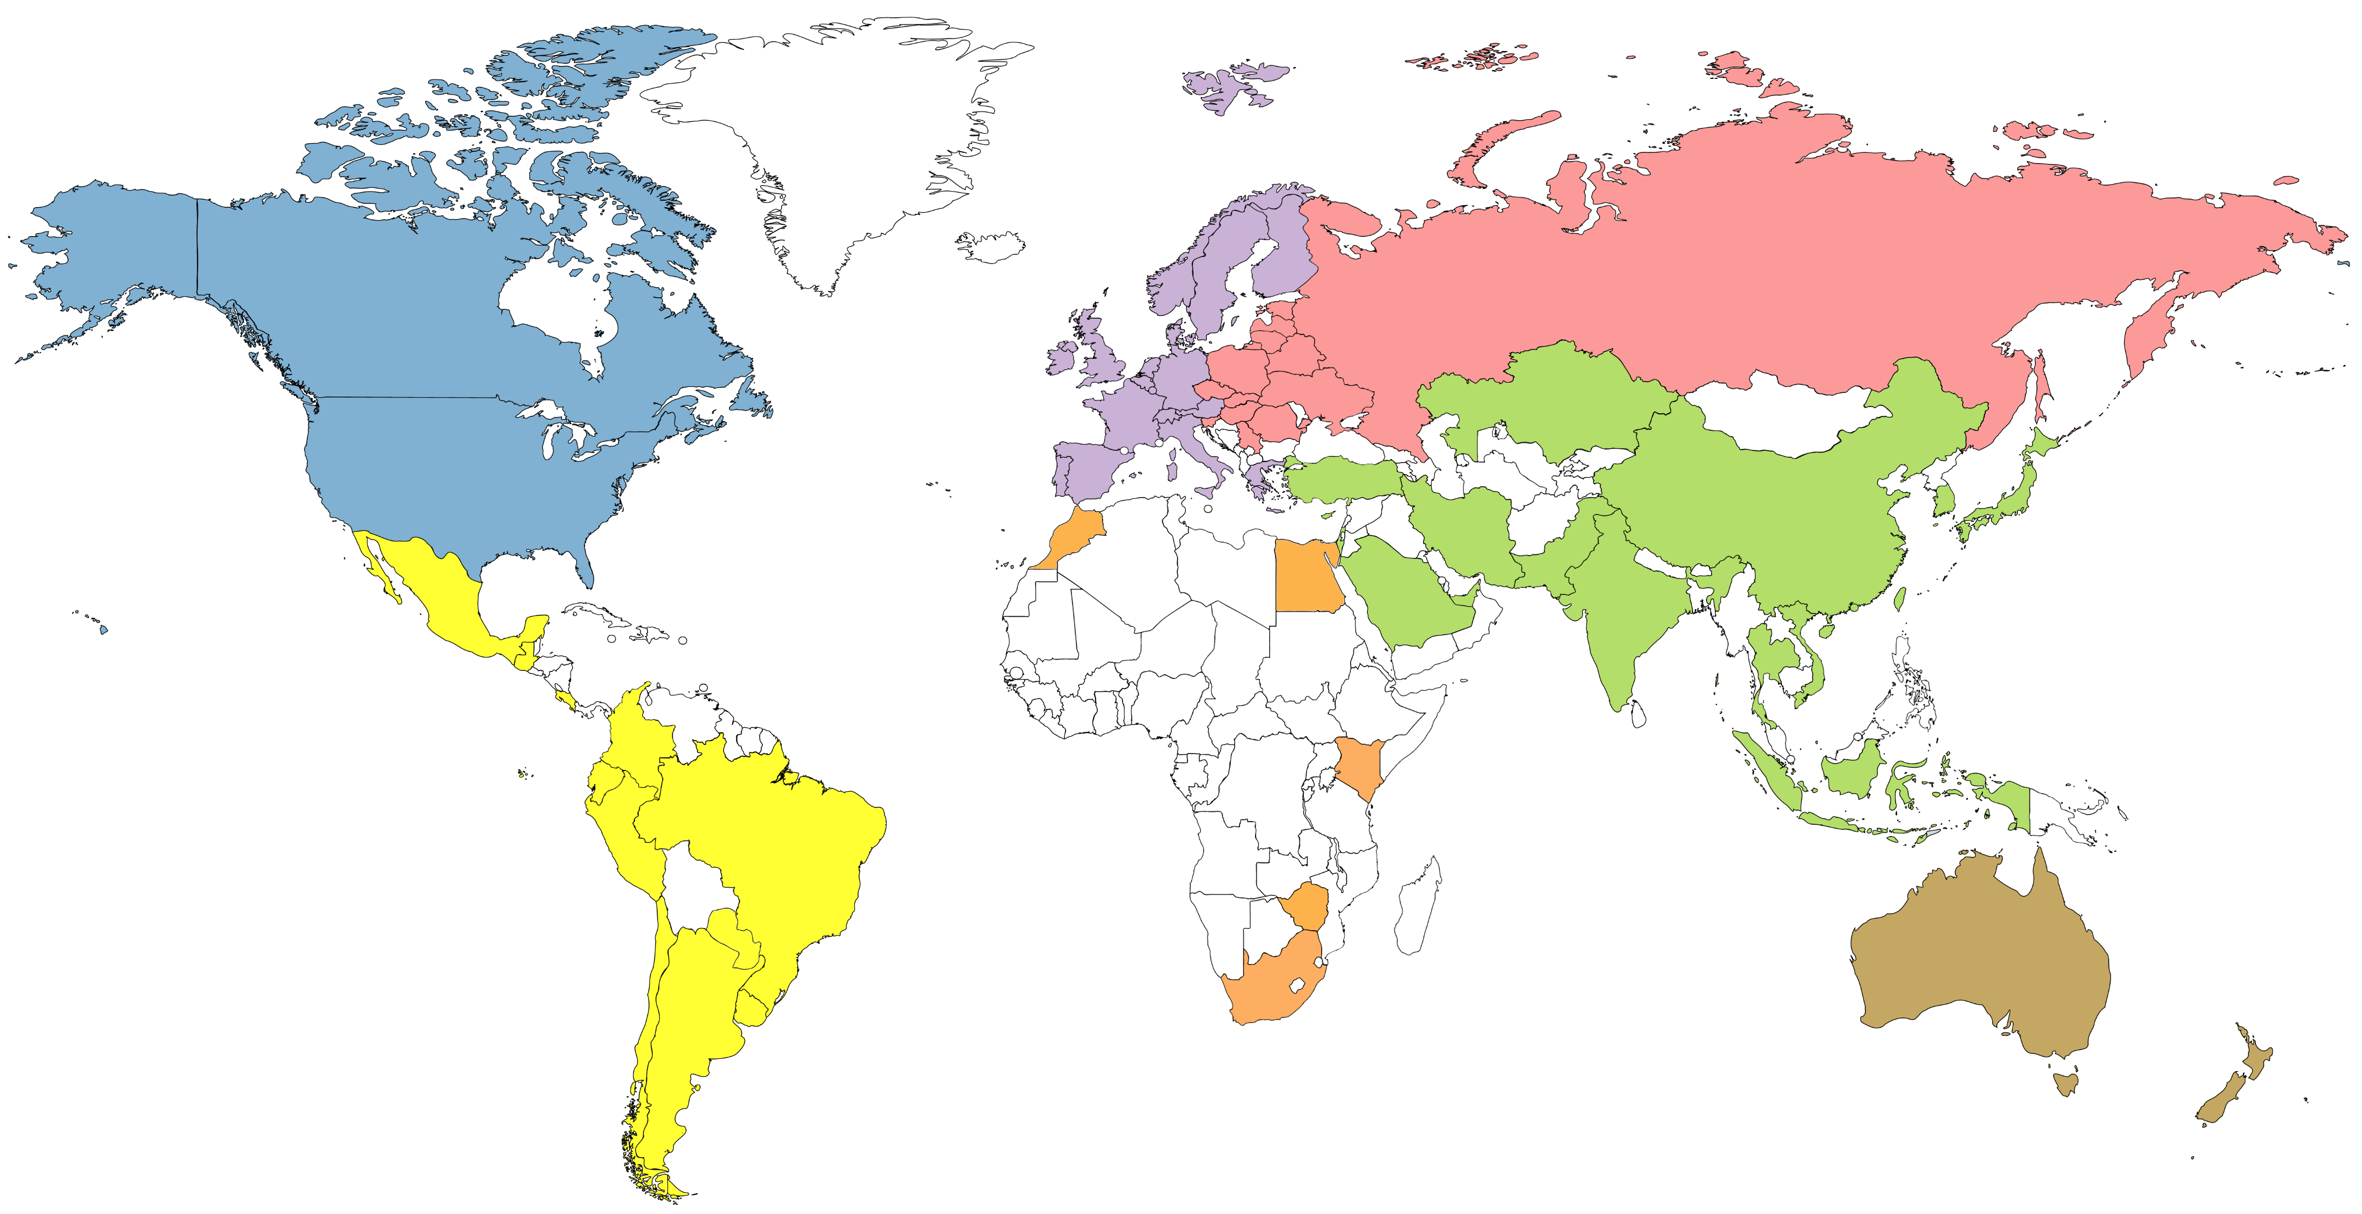
Genotyped animals in database (May 2025)
826,506
240,787
7,315,447
1,024,347
497,713
44,493
179,258

Slide 8
How does genetic improvement work?

Slide 9
Where are we today?
1890 avg. milk production¹
2022 avg. standardized milk yield (HO)²
1,088 kg
12,885 kg
!!! DISCLAIMER: many factors have changed in data recording and standardization over this 130-year period !!!
However, unmistakable progress has been made. How?
(1) genetic selection & (2) improving the environment of dairy cows
¹Hodgson (1956)
²CDCB WebConnect (2022)

Slide 10

How does genetic selection work?
ΔG = genetic gain each year
reliability = our certainty about an animal’s predicted genetic merit (genomics ⬆)
selection intensity = how selective we are when picking mates (management can ⬆)
genetic variance = genetic variation in the population (we can’t really change this)
generation interval = time between generations (genomics ⬇)
Cole and Spurlock (2016; https://ldhm.adsa.org/)

Slide 12
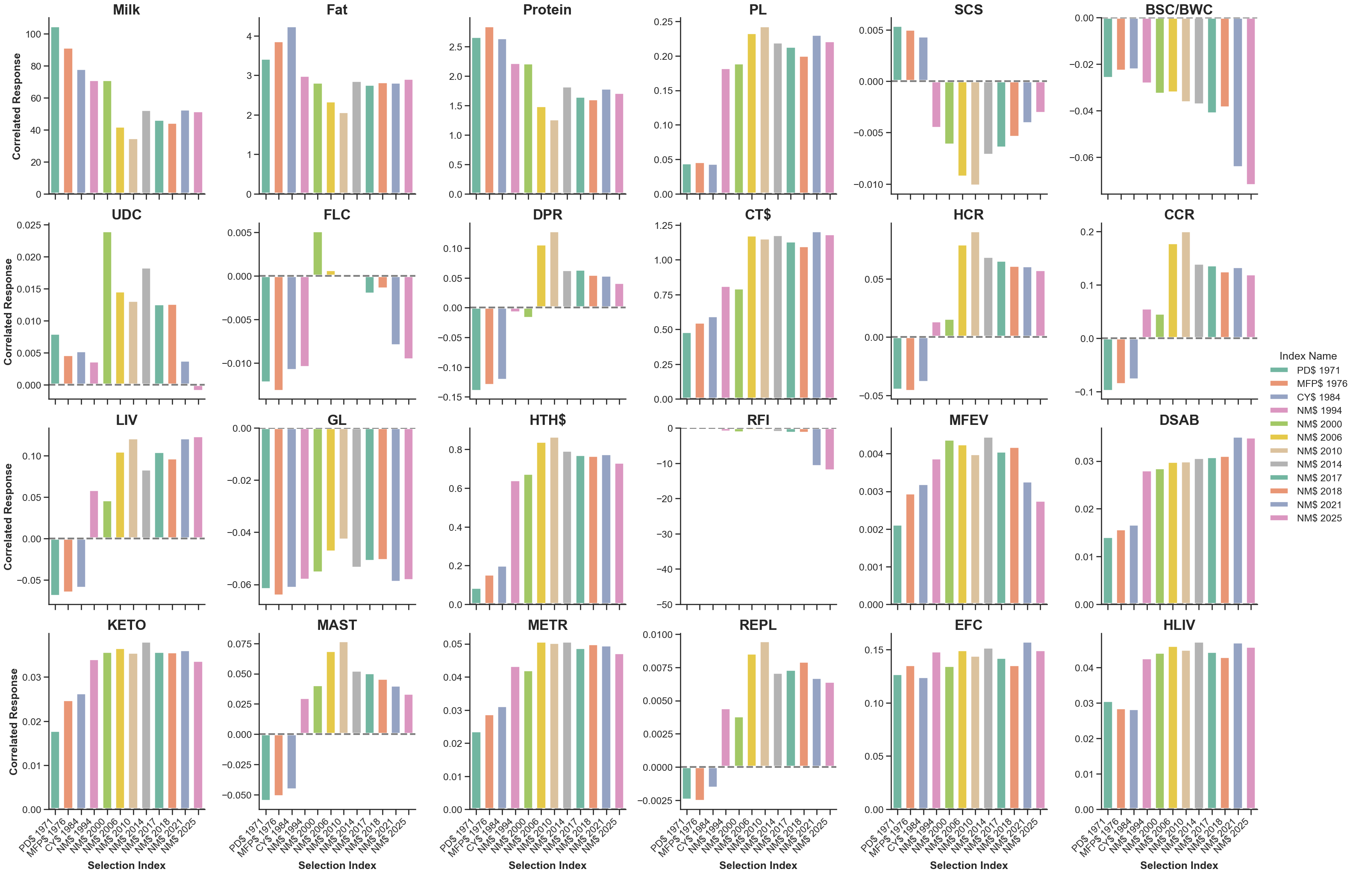
Cole (2025; https://doi.org/10.3168/jds.2024-25833)

Slide 13
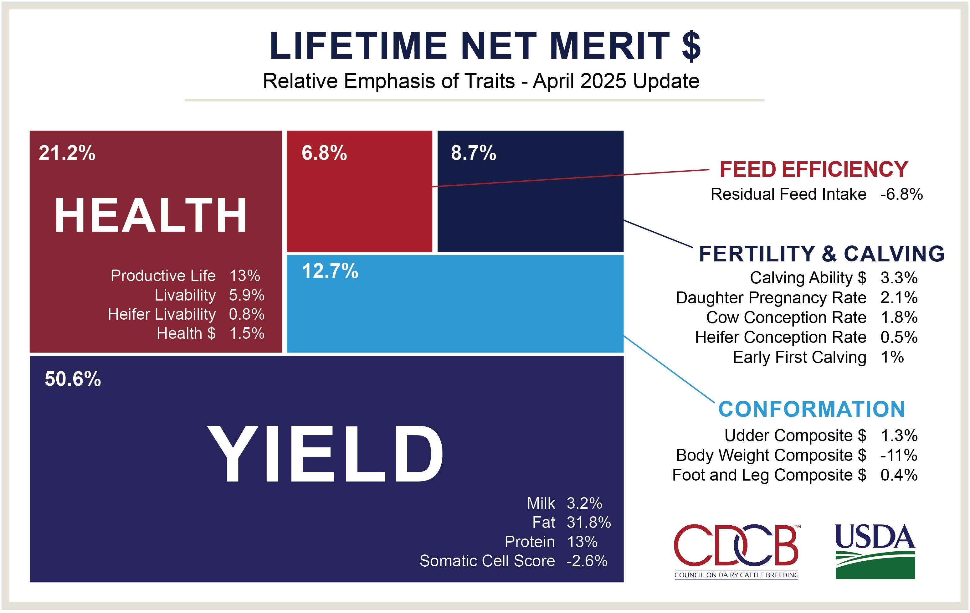
How do we deal with so many traits?

Slide 14
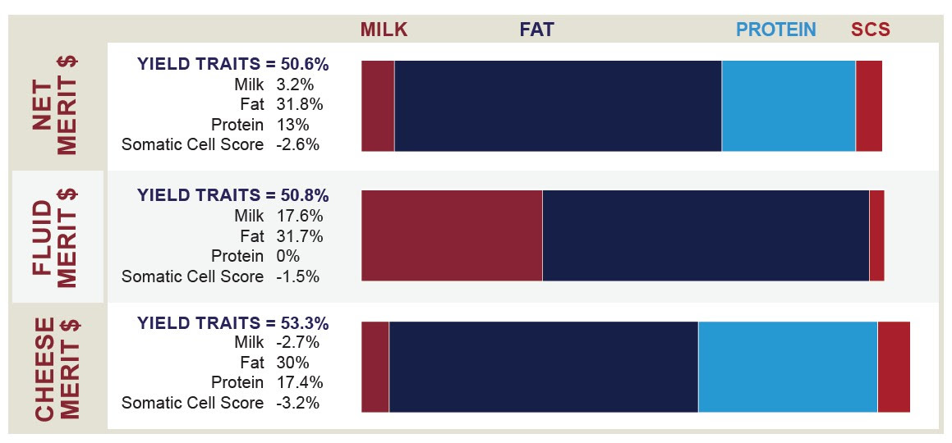
We have different tools for different payment schemes

Slide 16
What new tools are on the way?

Slide 17
Introduction of new traits
Heifer Conception Rate
Cow Conception Rate
GENOMICS
2014
Early First Calving
Crossbred Evaluations
1970
1990
2000
1980
2010
2020
NM$, FM$. CM$
Prod. Life
SCS
MFP$
Milk + Fat + Protein
Daughter Pregnancy Rate
2019
1976
1994
2003
Health (HO)
Health (BS)
2018
2022
2017
1971
1984
2000
2006
Livability
Gestation Length
PD$
Milk + Fat
CY$
Milk + Fat + Protein
BWC [5]
UC [9]
FLC [5]
Calving Ability $
[SCE, DCE,
SSB, DSB]
2013
2020
2025
CDCB begins providing evaluations
Heifer Livability
Residual Feed Intake
Feed Saved
Health (JE)
Milking Speed

Slide 18
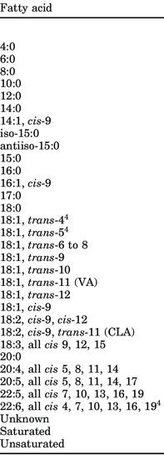
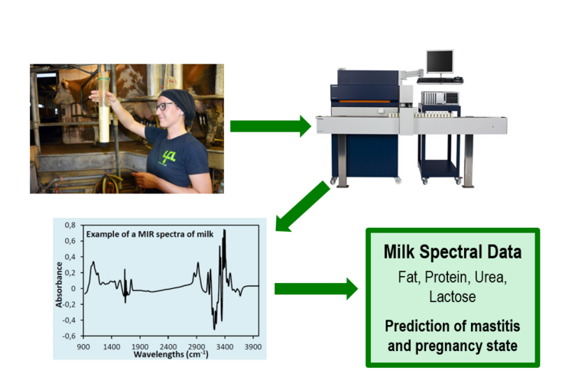
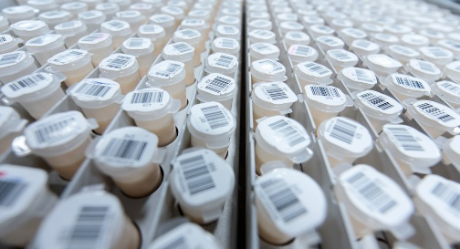
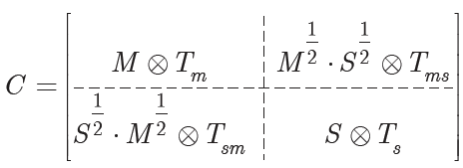
There’s unused value in milk samples!
Test-day sample
+
Milk Testing
Laboratory
Absorbance
Spectrum
Laboratory
Measurements
Use results to…
Predict Phenotypes
for All Tested Animals
Prediction
Equation

Slide 19
What about traits with no (current) market value?
Sustainability
  Greenhouse gas emissions (CH₄, CO₂, N₂O, etc.)
  Pressure on producers from milk buyers
Milk composition
  Fatty acids
  A2/A2 (some plants do pay)
  Cheese manufacturing properties (some plants do provide incentives)

Slide 20
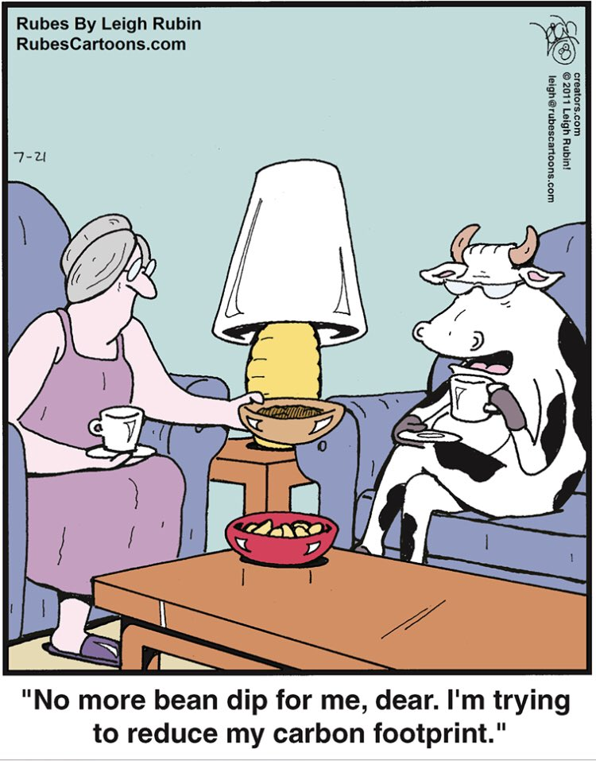
The cow of the future
Efficient
Smaller and rounder
Long-lived
Fertile
More solids
Heat-tolerant
Polled
Desirable carcass
Sustainable
Persistent

Slide 21
Closing thoughts
The cow of the future will produce milk with superior manufacturing properties
Genetic selection has been a key tool for increasing the amount of milk solids produced by today’s dairy cows
High-quality management and excellent environments are needed for those genetics to be expressed
Traits based on fine milk composition offer ways to increase the efficiency of cheese production

Slide 22
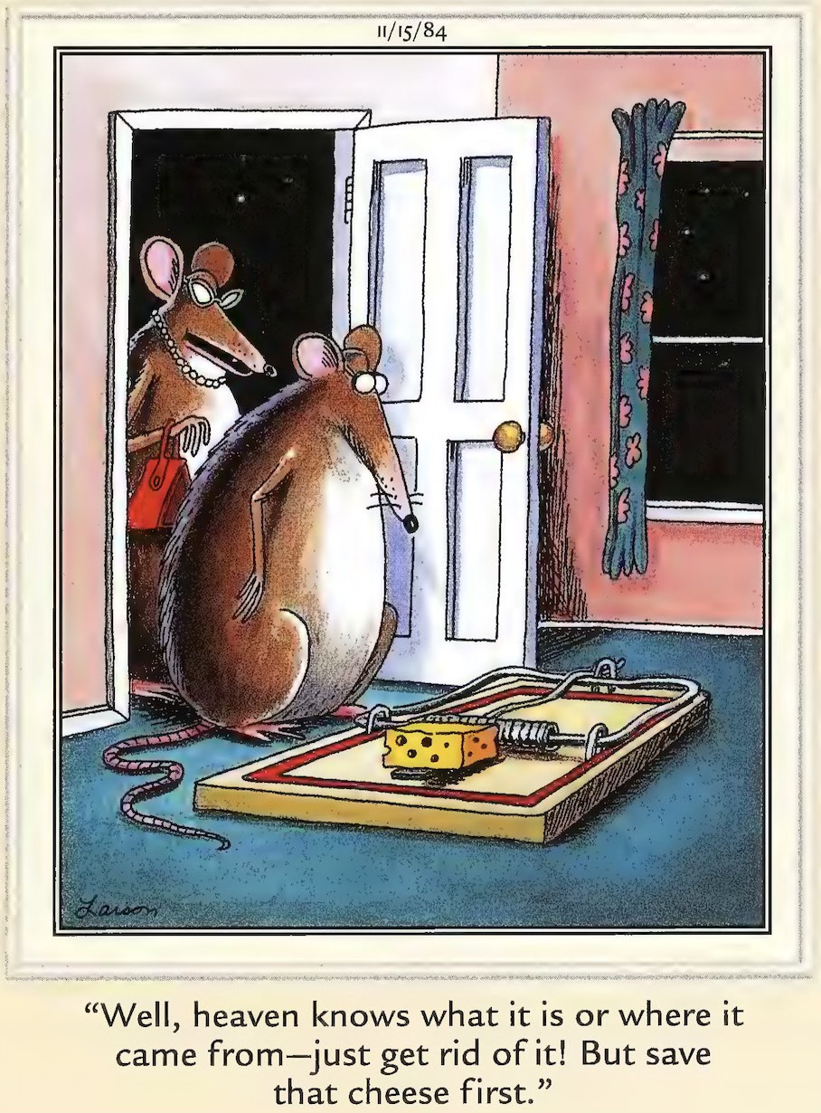
Questions?
Thank you for your
attention!
john.cole@uscdcb.com

